Slide 1
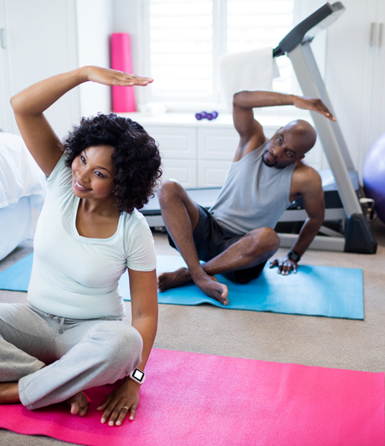
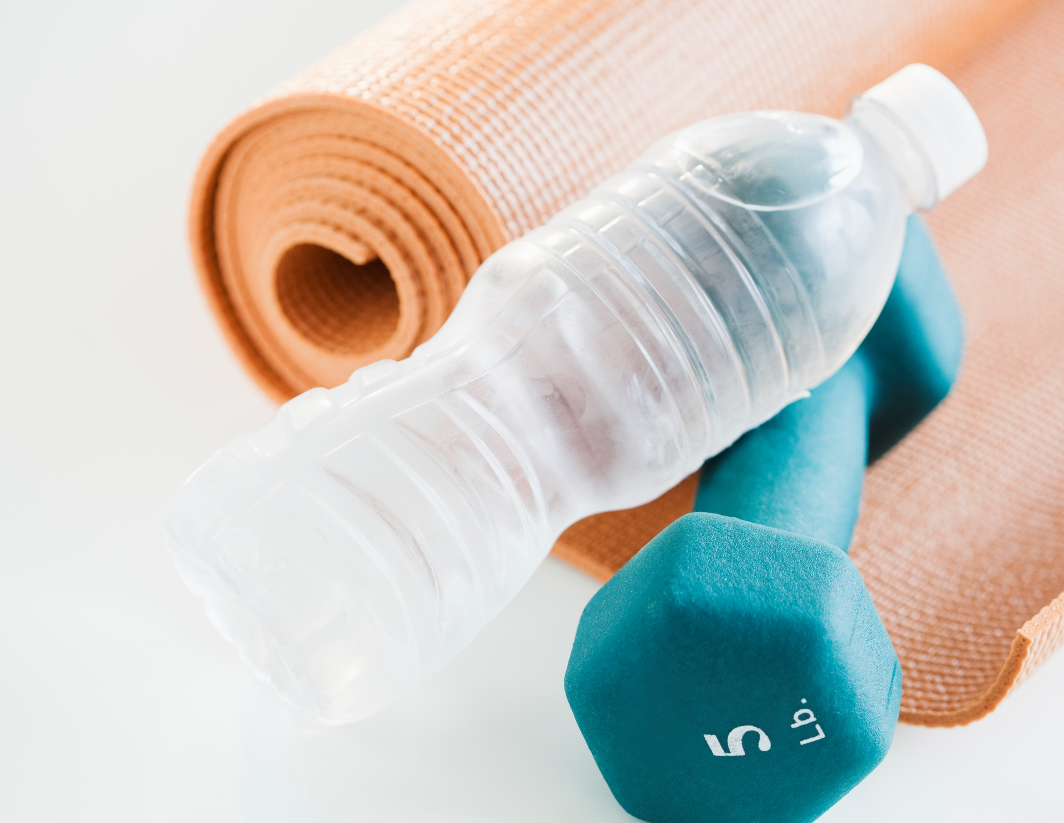



F
Little or no equipment
Easier to commit
Start whenever you want
IT
This Photo by Unknown Author is licensed under CC BY-SA-NC
Start your Fitness journey at home
FIT at Home
Coded by:
Ana Paola Martinez
Inspired Source:
https://github.com/ksu-is/Workout-Program-Generator

